Slide 1
Natural Language Processing
Dr. Rakhee Chhibber
HCLTECH

Slide 2
Introduction
NLP is one of the hottest areas of AI like text generators that compose coherent essays, chatbots that fool people into thinking they’re sentient, and text-to-image programs that produce photorealistic images of anything you can describe.
Recent years have brought a revolution in the ability of computers to understand human languages, programming languages, and even biological and chemical sequences, such as DNA and protein structures, that resemble language. The latest AI models are unlocking these areas to analyze the meanings of input text and generate meaningful, expressive output.

Slide 3
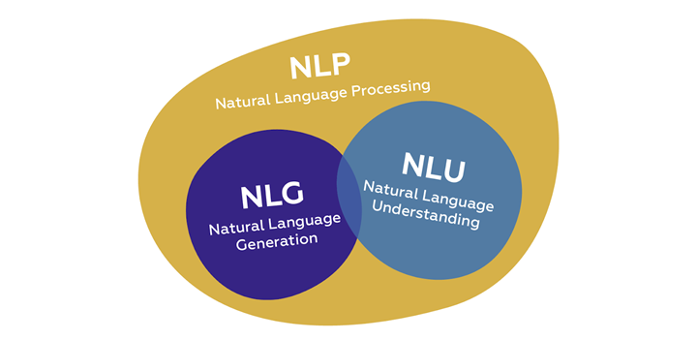
Components of NLP
Natural Language Understanding
Natural Language Generation

Slide 4
Natural Language Understanding
Natural Language Understanding (NLU) helps the machine to understand and analyze human language by extracting the text from large data such as keywords, emotions, relations, and semantics, etc.

Slide 5
Challenges for NLU
Lexical Ambiguity
Syntactical Ambiguity

Slide 6
Lexical Ambiguity
It happens when a word has different meanings. Lexical ambiguity can be resolved by using parts-of-speech (POS)tagging techniques.
For Example:-
He is looking for a match.
What do you understand by the ‘match’ keyword? Does it partner or cricket or football or anything else?

Slide 7
Syntactical Ambiguity
This means when we see more meanings in a sequence of words and also Called Grammatical Ambiguity
For Example
The Fish is ready to eat.
What do you understand by the above example? Is the fish ready to eat his/her food or fish is ready for someone to eat? Got confused!! Right?

Slide 8
Natural Language Generation
It is the process of extracting meaningful insights as phrases and sentences in the form of natural language.
It consists −
Text planning − It includes retrieving the relevant data from the domain.
Sentence planning − It is nothing but a selection of important words, meaningful phrases, or sentences.

Slide 9
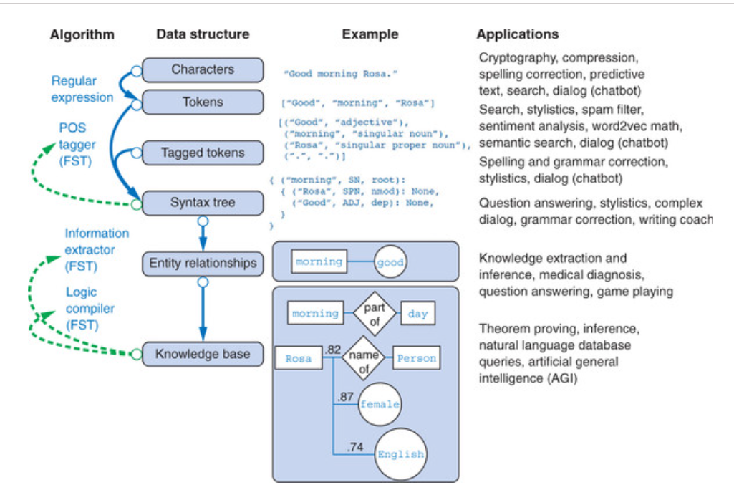

Slide 10
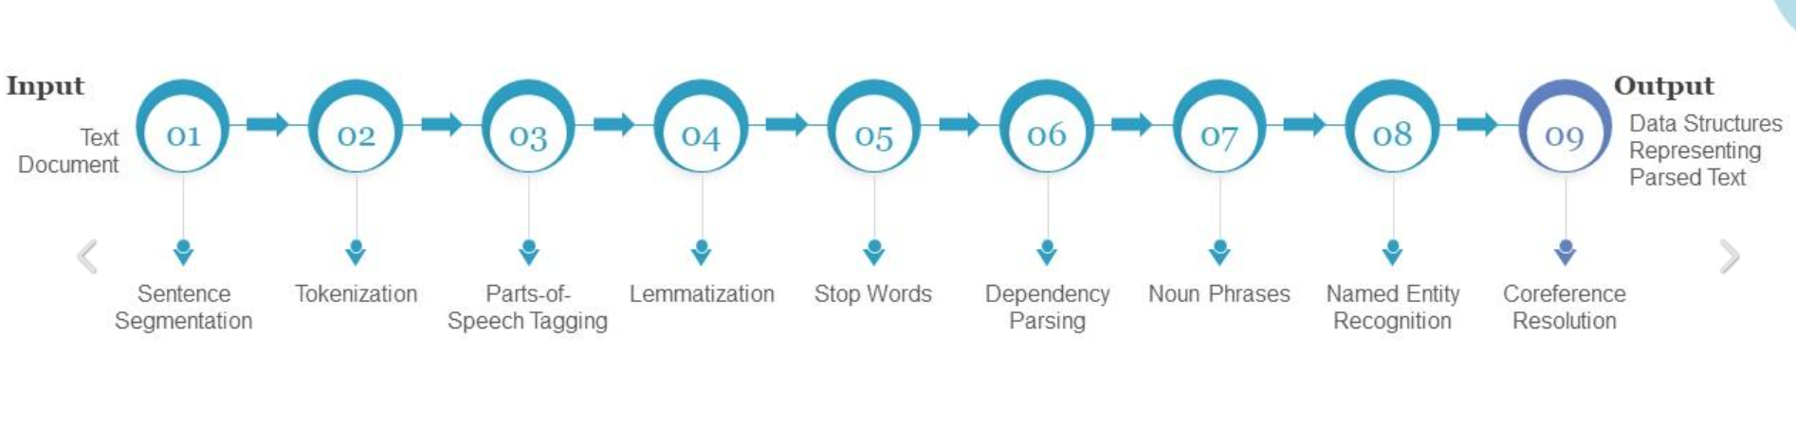

Slide 11
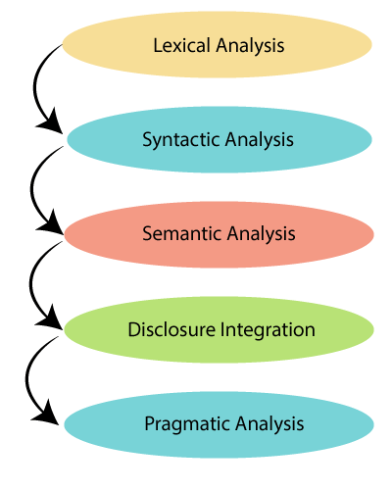
Phases of NLP

Slide 12
1. Lexical and Morphological Analysis
Lexical Analysis - It focuses on identifying and processing words (or lexemes) in a text. It breaks down the input text into individual tokens that are meaningful units of language such as words or phrases.

Slide 13
Key tasks in Lexical analysis
Tokenization: Process of dividing a text into smaller chunks called tokens. For example the sentence "I love programming" would be tokenized into ["I", "love", "programming"].
Part-of-Speech Tagging: Assigning parts of speech such as noun, verb, adjective to each token in the sentence. This helps us to understand grammatical roles of words in the context.

Slide 14
Tokenization
Tokenization is a fundamental process in Natural Language Processing (NLP) that involves breaking down a stream of text into smaller units called tokens. These tokens can range from individual characters to full words or phrases, Based on how detailed it needs to be. By converting text into these manageable chunks, machines can more effectively analyze and understand human language.

Slide 15
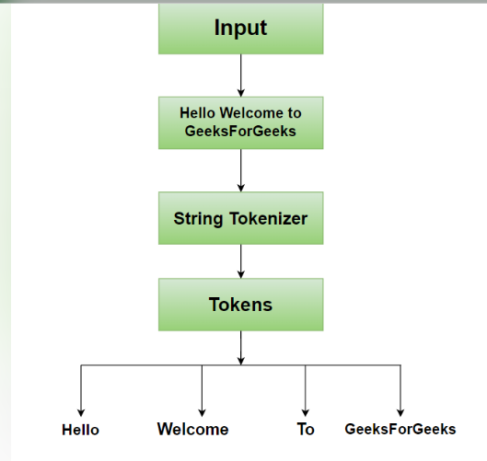
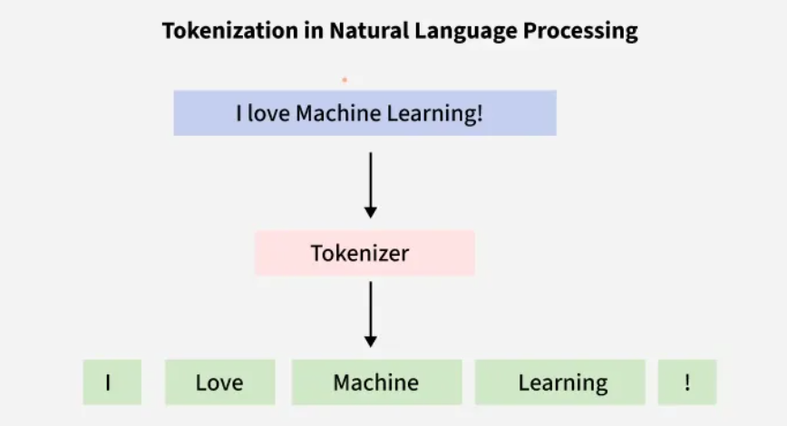

Slide 16
Tokenization Explained
Tokenization can be likened to teaching someone a new language by starting with the alphabet, then moving on to syllables, and finally to complete words and sentences. This process allows for the dissection of text into parts that are easier for machines to process.
For example, consider the sentence, "Chatbots are helpful." When tokenized by words, it becomes:
["Chatbots", "are", "helpful"]
If tokenized by characters, it becomes:
["C", "h", "a", "t", "b", "o", "t", "s", " ", "a", "r", "e", " ", "h", "e", "l", "p", "f", "u", "l"]
Each approach has its own advantages depending on the context and the specific NLP task at hand.

Slide 17
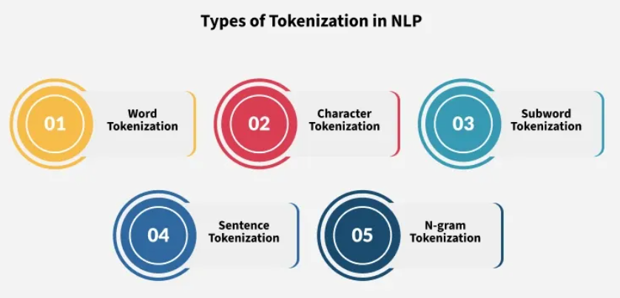
Types of Tokenization

Slide 18
Types of Tokenization
Word Tokenization: This is the most common method where text is divided into individual words. It works well for languages with clear word boundaries, like English.
Character Tokenization: In this method, text is split into individual characters. This is particularly useful for languages without clear word boundaries or for tasks that require a detailed analysis, such as spelling correction.
Sub-word Tokenization: Sub-word tokenization strikes a balance between word and character tokenization by breaking down text into units that are larger than a single character but smaller than a full word.
Sentence Tokenization: Sentence tokenization is also a common technique used to make a division of paragraphs or large set of sentences into separated sentences as tokens.
N-gram Tokenization: N-gram tokenization splits words into fixed-sized chunks (size = n) of data.

Slide 19
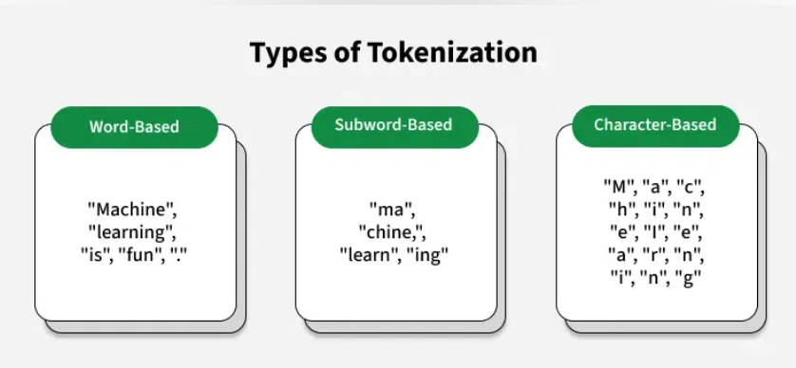

Slide 20
Basic Tokenization
Imports regex and collections.
Defines preprocess_text() to lowercase and tokenize text, keeping words and punctuation.
Processes a sample paragraph using this function.
Prints the list of tokens and the number of unique ones.
https://colab.research.google.com/drive/1J52Y9TM25A2QylacviO94YzfH8cs-WFG?authuser=7

Slide 21
Character-Level Tokenization
Defines a function create_char_vocabulary() that takes a list of word tokens.
For each word, it splits the word into characters and joins them with spaces.
It counts how many times each unique space-separated character sequence appears.
The vocabulary is stored as an OrderedDict, sorted by frequency.
Prints the top 10 most frequent character sequences.
https://colab.research.google.com/drive/1M12a75As_Dxa-yKpEGNXv9sG_B0Im7PR?authuser=7#scrollTo=iAu-V8iABefp

Slide 22
Byte-Pair Encoding Implementation
Initial Vocabulary: Words are split into characters with their frequencies (e.g., "l o w e r": 2).
Get Symbol Pairs: get_pairs counts how often each adjacent character pair appears.
Merge Step: merge_vocab replaces the most frequent pair with a combined token.
BPE Loop: Repeats merging the most common pair for a set number of times (5 here), updating the vocabulary each time.
Final Output: Prints the updated vocabulary after all merges, showing how characters group into subword units.
https://colab.research.google.com/drive/13kCtXHzRnx9DuHG3ybjMWSBVnsT-de9Q?authuser=7

Slide 23
Real-World Applications
Subword tokenization is essential in transformer models like GPT, BERT and T5.
GPT-2 uses Byte-Pair Encoding (BPE) on bytes, allowing it to process any Unicode text.
BERT uses WordPiece, which selects subword units based on how likely they are to appear.
Vocabulary size is compact (30k–50k tokens), making it efficient for memory and computation.
It replaces huge word lists (with millions of entries) while still handling a wide variety of words.

Slide 24
POS(Parts-Of-Speech) Tagging
Parts of Speech (PoS) tagging is a fundamental task in Natural Language Processing (NLP) where each word in a sentence is assigned a grammatical category such as noun, verb, adjective or adverb. This process help machines to understand the structure and meaning of sentences by identifying the roles of words and their relationships.

Slide 25
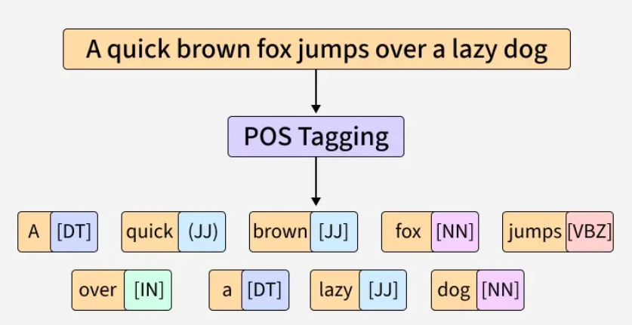

Slide 26
Key Concepts in POS Tagging
Parts of Speech: These are categories like nouns, verbs, adjectives, adverbs, etc that define the role of a word in a sentence.
Tagging: The process of assigning a specific part-of-speech label to each word in a sentence.
Corpus: A large collection of text data used to train POS taggers.

Slide 27
Example of POS Tagging
Consider the sentence: "The quick brown fox jumps over the lazy dog."
After performing POS Tagging, we get:
"The" is tagged as determiner (DT)
"quick" is tagged as adjective (JJ)
"brown" is tagged as adjective (JJ)
"fox" is tagged as noun (NN)
"jumps" is tagged as verb (VBZ)
"over" is tagged as preposition (IN)
"the" is tagged as determiner (DT)
"lazy" is tagged as adjective (JJ)
"dog" is tagged as noun (NN)

Slide 28
Working of POS Tagging
Tokenization: The input text is split into individual tokens (words or subwords), this step is necessary for further analysis.
Preprocessing: The text is cleaned such as converting it to lowercase and removing special characters, to improve accuracy.
Loading a Language Model: Tools like NLTK or SpaCy use pre-trained language models to understand the grammatical rules of the language, these models have been trained on large datasets.
Linguistic Analysis: The structure of the sentence is analyzed to understand the role of each word in context.
POS Tagging: Each word is assigned a part-of-speech label based on its role in the sentence and the context provided by surrounding words.
Evaluation: The results are checked for accuracy. If there are any errors or misclassifications, they are corrected.

Slide 29
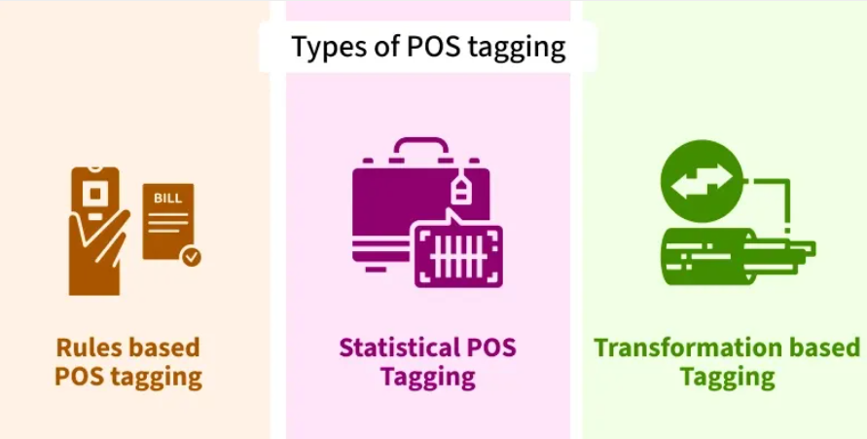
Types of POS Tagging

Slide 30
1. Rule-Based Tagging
Rule-based POS tagging assigns POS tags based on predefined grammatical rules. These rules are crafted based on morphological features (like word endings) and syntactic context, making the approach highly interpretable and transparent.
Example:
1. Rule: Assign the POS tag "Noun" to words ending in "-tion" or "-ment".
2. Sentence: "The presentation highlighted the key achievements of the project's development."
3. Tagged Output:
  "presentation" → Noun (N)
  "highlighted" → Verb (V)
  "development" → Noun (N)

Slide 31
2. Transformation-Based Tagging (TBT)
TBT refines POS tags through a series of context-based transformations. Unlike statistical taggers that rely on probabilities or rule-based taggers, it starts with initial tags and improves them iteratively by applying transformation rules.
Example:
Text: "The cat chased the mouse."
Initial Tags: "The" – DET, "cat" – NOUN, "chased" – VERB, "the" – DET, "mouse" – NOUN
Rule Applied: Change “chased” from Verb to Nounbecause it follows “the”.
Updated Tags: "chased" becomes Noun.

Slide 32
3. Statistical POS Tagging
It uses probabilistic models to assign grammatical categories (e.g noun, verb, adjective) to words in a text. Unlike rule-based methods which rely on handcrafted rules, it learns patterns from large annotated corpora using machine learning techniques.

Slide 33
Implementing POS Tagging with NLTK
Step 1: Installing Required Resources
Step 2: Applying POS Tagging
Step 3: Displaying Results
https://colab.research.google.com/drive/17Q6moMRTmp-HeOpTaAuvsDmMVcIIDCsV?authuser=7#scrollTo=E-x8hH67Gd1z

Slide 34
Implementing POS Tagging with SpaCy
Step 1: Installing and importing Required Resources
Step 2: Defining and Processing the Text
Step 3: Displaying POS Tagging
https://colab.research.google.com/drive/1JP0h3n6oW27hrRxL1UxLjwSD2w5UfnRy?authuser=7#scrollTo=cQ8oG7w_HJG4

Slide 35
Challenges of POS Tagging
Ambiguity: Words can have multiple meanings depending on the context which can make tagging difficult.
Idiomatic Expressions: Informal language and idioms may be hard to tag correctly.
Out-of-Vocabulary Words: Words that haven’t been seen before can lead to incorrect tagging.
Domain Dependence: Models may not work well outside the specific language domain they were trained on.

Slide 36
Example
Example: Consider the sentence: "I am reading a book."
Tokenization: Sentence is broken down into individual tokens or words: ["I", "am", "reading", "a", "book"]
Part-of-Speech Tagging: Each token is assigned a part of speech: ["I" → Pronoun (PRP), "am" → Verb (VBP), "reading" → Verb (VBG), "a" → Article (DT), "book" → Noun (NN)]

Slide 37
Importance of Lexical Analysis
Word Identification: It breaks text into tokens which helps the system to understand individual words for further processing.
Text Simplification: It simplifies text through tokenization and stemming which improves accuracy in NLP tasks.

Slide 38
Morphological Analysis
It deals with morphemes which are the smallest units of meaning in a word. It is important for understanding structure of words and their parts by identifying free morphemes (independent words like "cat") and bound morphemes (like prefixes or suffixes e.g. "un-" or "-ing").

Slide 39
Key tasks in morphological analysis:
Stemming: Reducing words to their root form like "running" to "run".
Lemmatization: Converting words to their base or dictionary form considering the context like "better" becomes "good".

Slide 40
Stemming
Stemming is an important text-processing technique that reduces words to their base or root form by removing prefixes and suffixes. This process standardizes words which helps to improve the efficiency and effectiveness of various natural language processing (NLP) tasks.

Slide 41
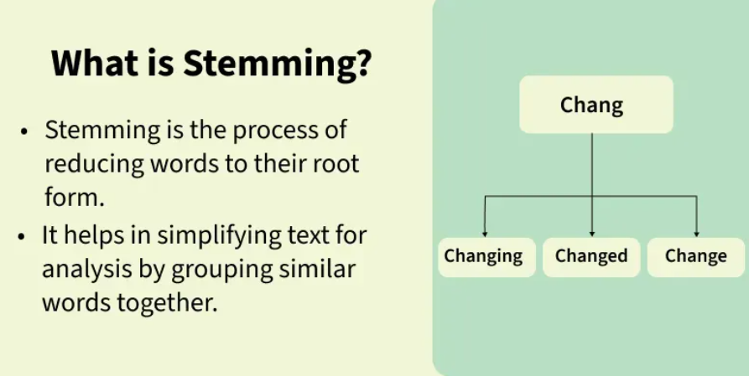

Slide 42
Stemming
It simplifies words to their most basic form, making it easier to analyze and process text. For example, "chocolates" becomes "chocolate" and "retrieval" becomes "retrieve". This is important in the early stages of NLP tasks where words are extracted from a document and tokenized (broken into individual words).
It helps in tasks such as text classification, information retrieval and text summarization by reducing words to a base form. While it is effective, it can sometimes introduce drawbacks including potential inaccuracies and a reduction in text readability.
Examples of stemming for the word "like":
"likes" → "like"
"liked" → "like"
"likely" → "like"
"liking" → "like"

Slide 43
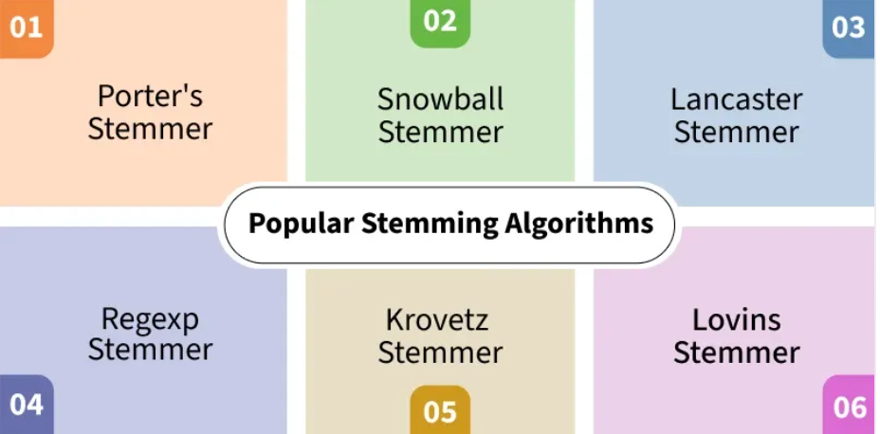
Types of Stemmer in NLTK
https://colab.research.google.com/drive/1_r9rSNh5O2qcL6MVRe3fGTMocoE2sBOw?authuser=7#scrollTo=XIaF2OWVK5MS

Slide 44
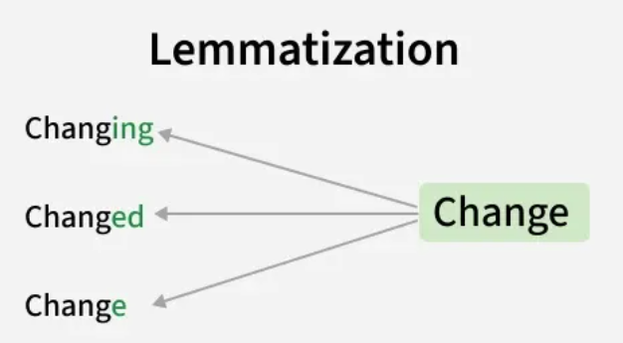
Lemmatization
Lemmatization is an important text pre-processing technique in Natural Language Processing (NLP) that reduces words to their base form known as a "lemma." For example, the lemma of "running" is "run" and "better" becomes "good." Unlike stemming which simply removes prefixes or suffixes, it considers the word's meaning and part of speech (POS) and ensures that the base form is a valid word. This makes lemmatization more accurate as it avoids generating non-dictionary words.

Slide 45
Importance of lemmatization
Improves accuracy: It ensures words with similar meanings like "running" and "ran" are treated as the same.
Reduced Data Redundancy: By reducing words to their base forms, it reduces redundancy in the dataset. This leads to smaller datasets which makes it easier to handle and process large amounts of text for analysis or training machine learning models.
Better NLP Model Performance: By treating all similar word as same, it improves the performance of NLP models by making text more consistent. For example, treating "running," "ran" and "runs" as the same word improves the model's understanding of context and meaning.

Slide 46
Lemmatization Techniques
1. Rule Based Lemmatization
In rule-based lemmatization, predefined rules are applied to a word to remove suffixes and get the root form. This approach works well for regular words but may not handle irregularities well.
For example:
Rule: For regular verbs ending in "-ed," remove the "-ed" suffix.
Example: "walked" -> "walk"
While this method is simple and interpretable, it doesn't account for irregular word forms like "better" which should be lemmatized to "good".

Slide 47
2. Dictionary-Based Lemmatization
It uses a predefined dictionary or lexicon such as WordNet to look up the base form of a word. This method is more accurate than rule-based lemmatization because it accounts for exceptions and irregular words.
For example:
'running' -> 'run'
'better' -> 'good'
'went' -> 'go
"I was running to become a better athlete and then I went home," -> "I was run to become a good athlete and then I go home."
By using dictionaries like WordNet this method can handle a range of words effectively, especially in languages with well-established dictionaries.

Slide 48
3. Machine Learning-Based Lemmatization
It uses algorithms trained on large datasets to automatically identify the base form of words. This approach is highly flexible and can handle irregular words and linguistic nuances better than the rule-based and dictionary-based methods.
For example:
A trained model may deduce that “went” corresponds to “go” even though the suffix removal rule doesn’t apply. Similarly, for 'happier' the model deduces 'happy' as the lemma.
Machine learning-based lemmatizers are more adaptive and can generalize across different word forms which makes them ideal for complex tasks involving diverse vocabularies.

Slide 49
Implementation of Lemmatization in Python
Step 1: Installing NLTK and Downloading Necessary Resource
Step 2: Lemmatizing Text with NLTK
Step 3: Improving Lemmatization with Part of Speech (POS) Tagging
https://colab.research.google.com/drive/1FvV9nw6K2xlmmvn6TYd180bREcidTZVG?authuser=7#scrollTo=9gpKHvyAM-O1

Slide 50
Importance of Morphological Analysis
Understanding Word Structure: It helps in breaking the composition of complex words.
Improving Accuracy: It enhances accuracy of tasks such as part-of-speech tagging, syntactic parsing and machine translation.
By identifying and analyzing morphemes system can identify text correctly at the most basic level which helps in more advanced NLP applications

Slide 51
2. Syntactic Analysis (Parsing)
Syntactic Analysis helps in understanding how words in a sentence are arranged according to grammar rules. It ensures that the sentence follows correct grammar which makes the meaning clearer. The goal is to create a parse tree which is a diagram showing the structure of sentence. It breaks the sentence into parts like the subject, verb and object and shows how these parts are connected. This helps machines understand the relationships between words in the sentence.

Slide 52
Key components of syntactic analysis include:
POS Tagging: Assigning parts of speech (noun, verb, adjective) to words in a sentence as discussed earlier.
Ambiguity Resolution: Handling words that have multiple meanings (e.g "book" can be a noun or a verb).

Slide 53
Example
Consider the following sentences:
Correct Syntax: "John eats an apple."
Incorrect Syntax: "Apple eats John an."
Despite using same words only the first sentence is grammatically correct and makes sense. The correct arrangement of words according to grammatical rules is what makes the sentence meaningful. By analyzing sentence structure NLP systems can better understand and generate human language. This helps in tasks like machine translation, sentiment analysis and information retrieval by making the text clearer and reducing confusion.

Slide 54
https://www.geeksforgeeks.org/nlp/understanding-semantic-analysis-nlp/
Understanding Semantic Analysis

Slide 55
3. Semantic Analysis
Semantic Analysis focuses on understanding meaning behind words and sentences. It ensures that the text is not only grammatically correct but also logically coherent and contextually relevant. It aims to understand dictionary definitions of words and their usage in context and also find whether the arrangement of words in a sentence makes logical sense.

Slide 56
4. Discourse Integration
It is the process of understanding how individual sentences or segments of text connect and relate to each other within a broader context. This phase ensures that the meaning of a text is consistent and coherent across multiple sentences or paragraphs. It is important for understanding long or complex texts where meaning focuses on previous statements.

Slide 57
Key aspects of discourse integration:
Anaphora Resolution: Anaphora refers to the use of pronouns or other references that depend on earlier parts of the text. For example in the sentence "Taylor went to the store. She bought groceries" pronoun "She" refers back to "Taylor." It ensures that references like these are correctly understood by linking them to their antecedents.
Contextual References: Many words or phrases can only be fully understood when considered in the context of following sentences. It helps in interpreting how certain words or phrases focuses on context. For example "It was a great day" is clearer when you know what event or situation is being discussed.

Slide 58
Example of Discourse Integration
"Taylor went to the store to buy some groceries. She realized she forgot her wallet." Understanding that "Taylor" is the antecedent of "she" is important for understanding sentence's meaning.
"This is unfair!" helps in understand what "this" refers to we need to identify following sentences. Without context statement's meaning remains unclear.
It is important for NLP applications like machine translation, chatbots and text summarization. It ensures that meaning remains same across sentences which helps machines to understand context. This enables accurate and natural responses in applications like conversational AI and document translation.

Slide 59
5. Pragmatic Analysis
Pragmatic analysis helps in understanding the deeper meaning behind words and sentences by looking beyond their literal meanings. While semantic analysis looks at the direct meaning it considers the speaker's or writer's intentions, tone and context of the communication.

Slide 60
Key tasks in pragmatic analysis:
Understanding Intentions: Sometimes language doesn’t mean what it says literally. For example when someone asks "Can you pass the salt?" it's not about ability but a polite request. It helps to understand true intention behind such expressions.
Figurative Meaning: Language often uses idioms or metaphors that can’t be taken literally.

Slide 61
Examples of Pragmatic Analysis
"Hello! What time is it?" here it might be a straightforward request for the current time but it could also imply concern about being late.
For example "I’m falling for you" means "I love you" not literally falling. It helps to interpret these non-literal meanings.
It is important for NLP tasks like sentiment analysis, chatbots and conversation-based AI. It helps machines to understand the speaker's intentions, tone and context which go beyond the literal meaning of words. By identifying sarcasm and emotions this help systems to respond naturally which improves human-computer interaction. By combining these phases NLP systems can effectively interpret, analyze and generate human language making more intelligent and natural interactions between humans and machines.

Slide 63
Slide Title
Make Effective Presentations
Using Awesome Backgrounds
Engage your Audience
Capture Audience Attention

Slide 64
Slide Title
Make Effective Presentations
Using Awesome Backgrounds
Engage your Audience
Capture Audience Attention

Slide 65
Slide Title
Product A
Product B
Feature 1
Feature 2
Feature 3
Feature 1
Feature 2
Feature 3

Slide 66


